Slide 1
SCC204 Software Design
(Workshop-Style)
Zhang Jinyu – zjy@bjtu.edu.cn
School of Computer and Information Technology
SD408

Slide 2
Architectural Design Example: ICU
A hospital intensive care unit (ICU) with 100 beds is designed to monitor the blood pressure, heart rate and respiration rate of a number of patients
nurse can reset the monitoring equipment ready for another emergency. – Each patient is in a bed, which has its own individual set of monitoring equipment and an alarm. Each bed has three monitors, each of which can measure one of the three vital signs described
– The monitoring equipment is communicates with a central management system, which in turn provides a display the current values of the vital signs of any patient
– The management system also maintains a record of the emergency calls received from each bed
– When the monitoring equipment detects an abnormal change in a patient’s state, it sets off the alarm and communicates the state of the patient to the management system, which updates its display and pages the relevant nurse. After dealing with the emergency,
Your Task
1. Use a box and line diagram to identify possible sub-systems for the ICU monitoring system.
呼吸率

Slide 3
Hints
1. What are the major functions the system needs to carry out?
2. Associate the major system functions with sub-systems by grouping together logically similar functions
3. What architectural style best suits the system?
– i.e. based on the system description, how should the sub-systems interact
4. Decompose each sub-system to show further sub-systems or modules
– What is the configuration of the modules in each subsystem (i.e. how are they linked – See (3) above for hint)?

Slide 4
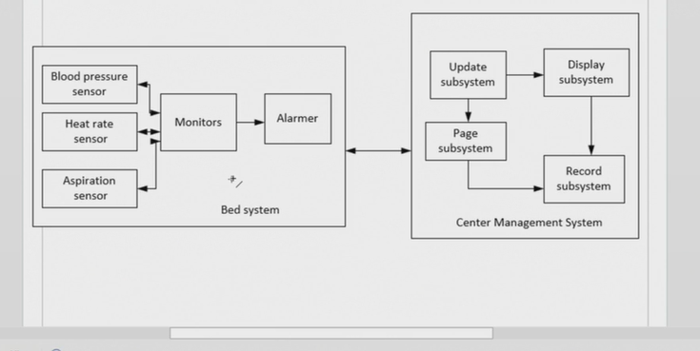

Slide 5
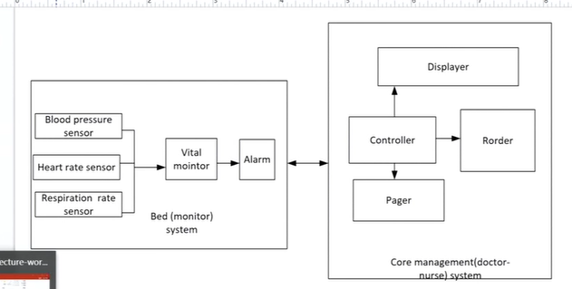

Slide 6
